Slide 1
Cyber Security
Module 5

Slide 2
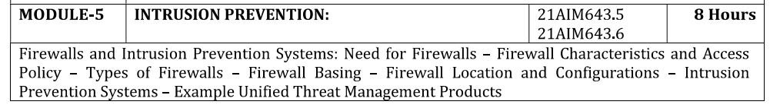

Slide 3

Firewalls can be an effective means of protecting a local system or network of systems from network-based security threats while at the same time affording access to the outside world via wide area networks and the Internet.
Firewalls are essential components of cyber security infrastructure for several critical reasons:
Network Security: Firewalls act as a barrier between a trusted internal network and untrusted external networks (like the internet). They inspect incoming and outgoing traffic based on predetermined security rules, thereby preventing unauthorized access and potential cyber attacks.
Access Control: By defining and enforcing access control policies, firewalls ensure that only legitimate connections and data packets are allowed into or out of the network. This helps in protecting sensitive information and resources from malicious actors.
Threat Mitigation: Firewalls can detect and block common types of cyber threats such as malware, ransomware, viruses, and phishing attempts. They monitor traffic patterns and behaviors to identify suspicious activities and respond accordingly.

Slide 4
Regulatory Compliance: Many industries and jurisdictions have specific cybersecurity regulations and standards that require organizations to implement adequate firewall protection. Compliance helps avoid legal issues and demonstrates a commitment to data security.
Privacy and Confidentiality: Firewalls contribute to maintaining the confidentiality of data by preventing unauthorized access. This is crucial for protecting sensitive information such as personal data, financial records, and intellectual property.
Application Security: In addition to traditional network firewalls, there are also application firewalls that provide security at the application layer. These firewalls monitor and control specific applications to protect against application-layer attacks and vulnerabilities.
Firewalls play a fundamental role in safeguarding networks, systems, and data from a wide range of cyber threats. They are an indispensable part of any comprehensive cyber security strategy, providing proactive defense and reducing the risk of cyber incidents.

Slide 5
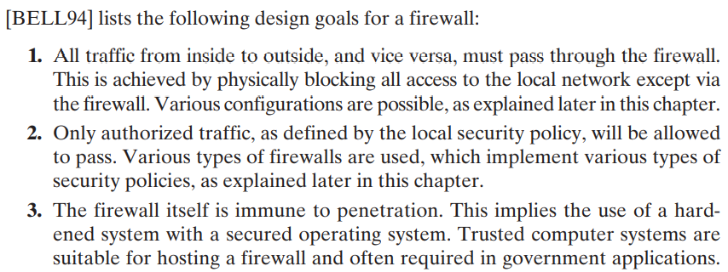

Slide 6
IP Address and Protocol Values: Controls access based on the source or destination addresses and port numbers, direction of flow being inbound or outbound, and other network and transport layer characteristics. This type of filtering is used by packet filter and stateful inspection firewalls. It is typically used to limit access to specific services.
Application Protocol: Controls access on the basis of authorized application protocol data. This type of filtering is used by an application-level gateway that relays and monitors the exchange of information for specific application protocols, e.g., checking SMTP email for spam, or HTPP web requests to authorized sites only.
User Identity: Controls access based on the users identity, typically for inside users who identify themselves using some form of secure authentication technology, such as IPSec (Chapter 22).
Network Activity: Controls access based on considerations such as the time or request, e.g., only in business hours; rate of requests, e.g., to detect scanning attempts; or other activity patterns.

Slide 7
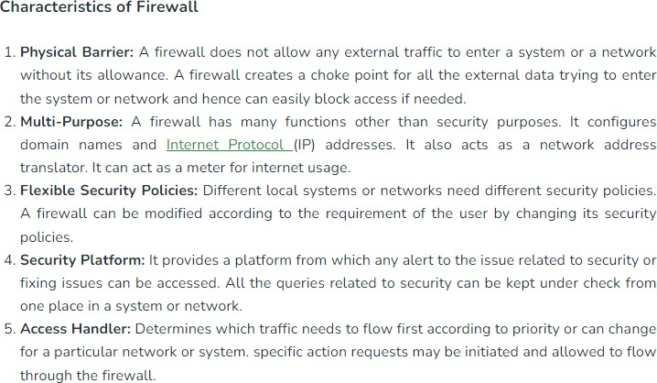

Slide 8
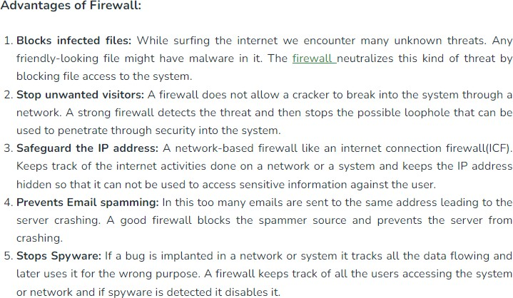

Slide 9
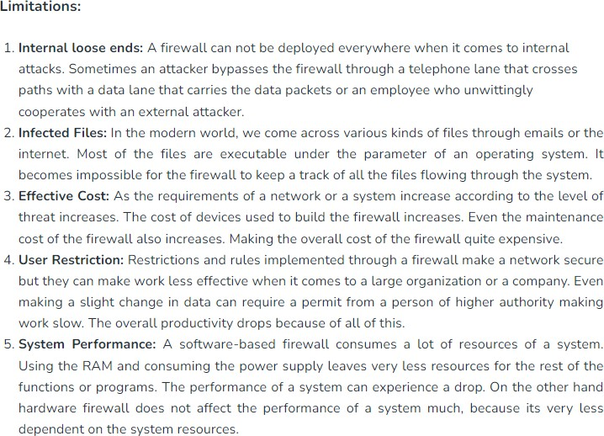
Notes:
Before proceeding to the details of firewall types and configurations, it is best to summarize what one
can expect from a firewall.

Slide 10
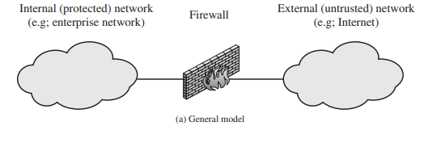
A firewall can monitor network traffic at a number of levels, from low-level network packets, either individually or as part of a flow, to all traffic within a transport connection, up to inspecting details of application protocols. The choice of which level is appropriate is determined by the desired firewall access policy. It can operate as a positive filter, allowing to pass only packets that meet specific criteria, or as a negative filter, rejecting any packet that meets certain criteria. Depending on the type of firewall, it may examine one or more protocol headers in each packet, the payload of each packet, or the pattern generated by a sequence of packets.
Packet Filtering Firewall
Stateful Inspection Firewall
Application Level Gateway
Circuit Level Gateway

Slide 11
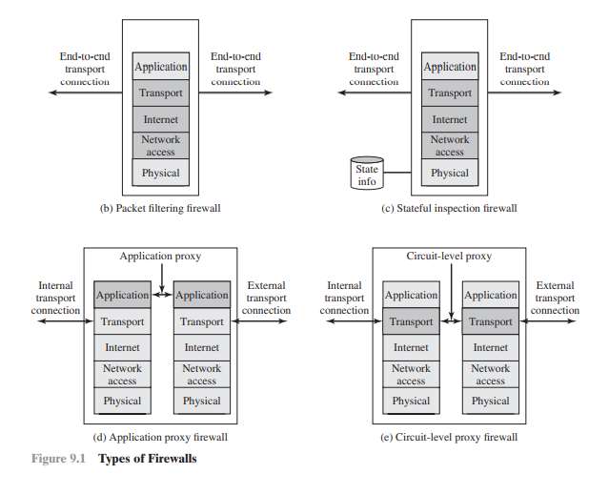
Packet Filtering Firewall
Stateful Inspection Firewall
Application Level Gateway
Circuit Level Gateway

Slide 12
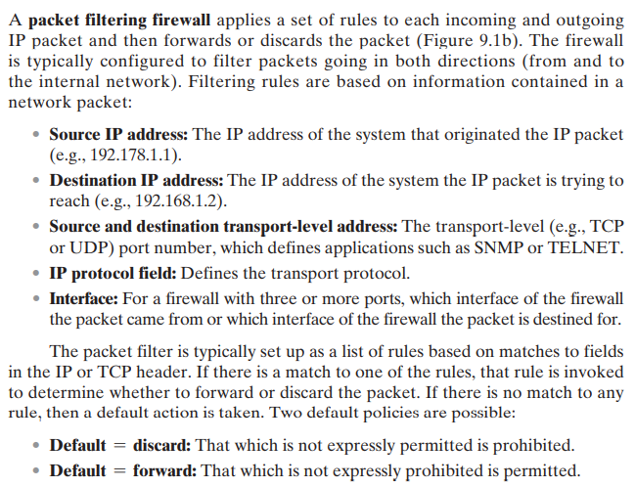
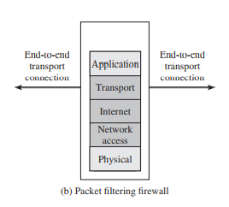
Packet Filtering Firewall

Slide 13
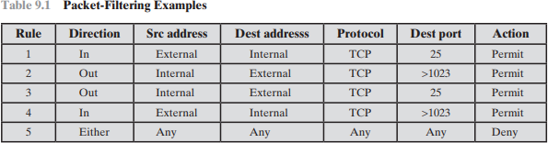
Table 9.1 is a simplified example of a rule set for SMTP traffic. The goal is to allow inbound and outbound email traffic
but to block all other traffic. The rules are applied top to bottom to each packet. The intent of each rule is:
Inbound mail from an external source is allowed (port 25 is for SMTP incoming).
This rule is intended to allow a response to an inbound SMTP connection.
Outbound mail to an external source is allowed.
This rule is intended to allow a response to an inbound SMTP connection.
This is an explicit statement of the default policy. All rule sets include this rule implicitly as the last rule.

Slide 14
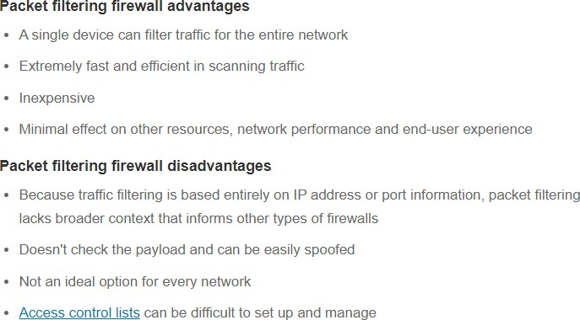

Slide 15
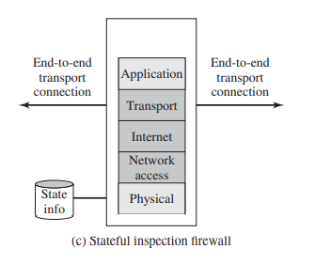
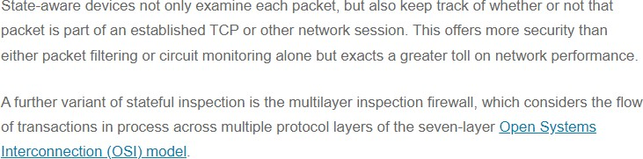
Stateful Inspection Firewalls
A stateful packet inspection firewall tightens up the rules for TCP traffic by creating a directory of outbound TCP connections, as shown in Table 9.2. There is an entry for each currently established connection. The packet filter will now allow incoming traffic to high-numbered ports only for those packets that fit the profile of one of the entries in this directory.
A stateful packet inspection firewall reviews the same packet information as a packet filtering firewall, but also records information about TCP connections (Figure 9.1c). Some stateful firewalls also keep track of TCP sequence numbers to prevent attacks that depend on the sequence number, such as session hijacking. Some even inspect limited amounts of application data for some well-known protocols like FTP, IM, and SIPS commands, in order to identify and track related connections.

Slide 16
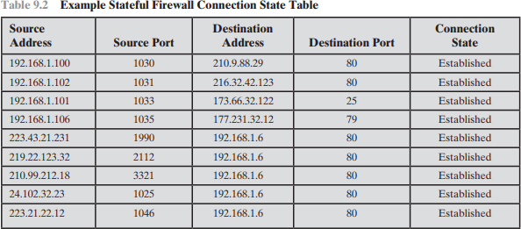

Slide 17
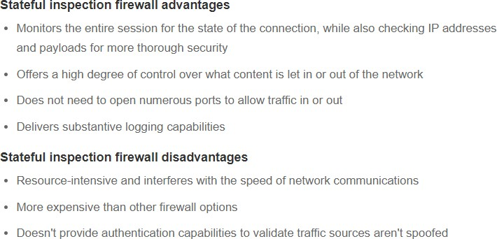

Slide 18
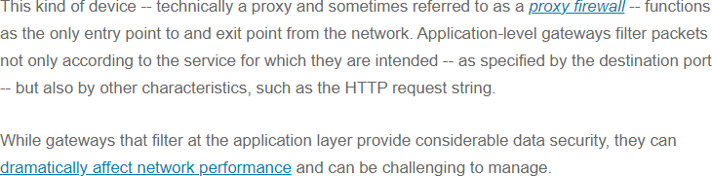
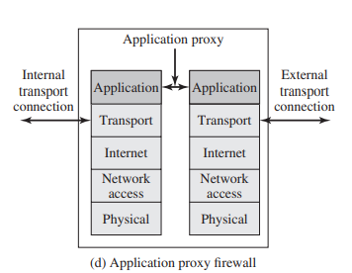
Application-Level Gateway

Slide 19
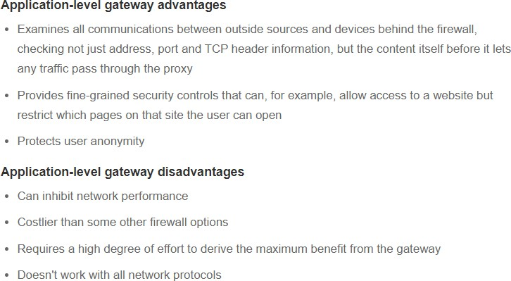

Slide 20
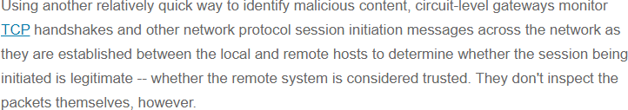
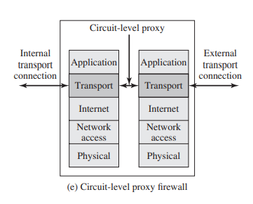
Circuit-Level Gateway

Slide 21
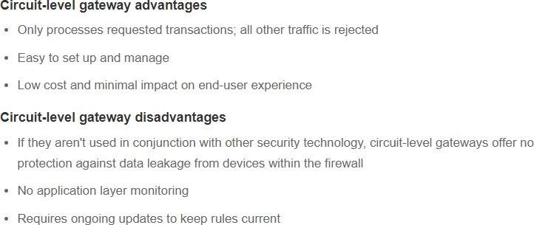

Slide 22

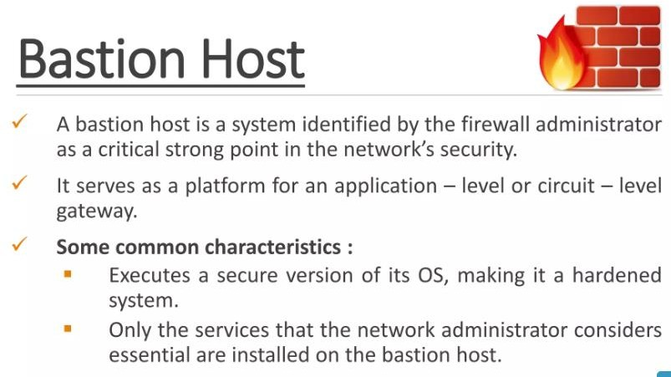

Slide 23
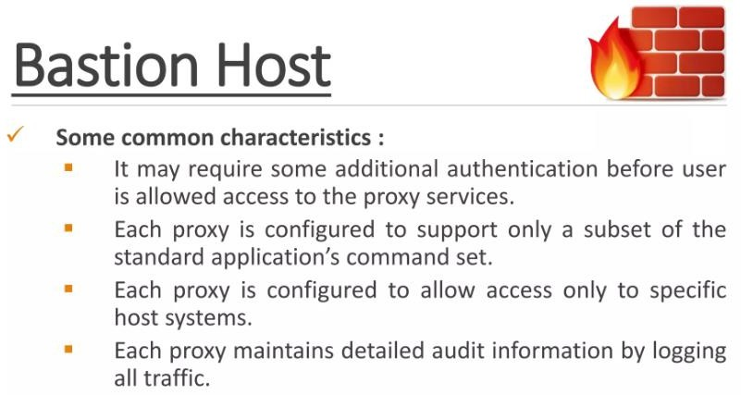

Slide 24
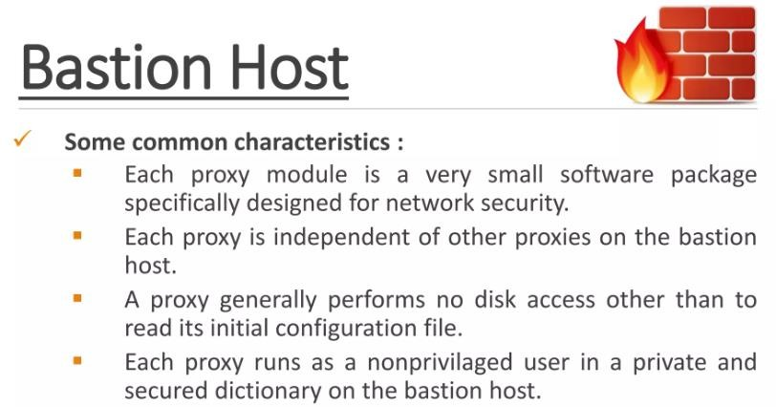

Slide 25
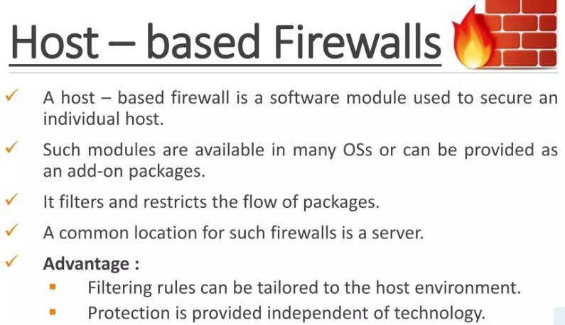

Slide 26
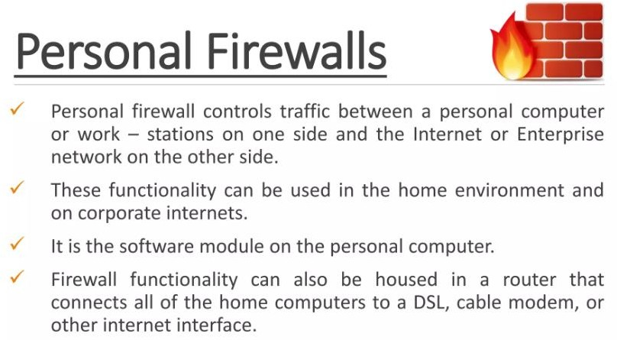

Slide 27
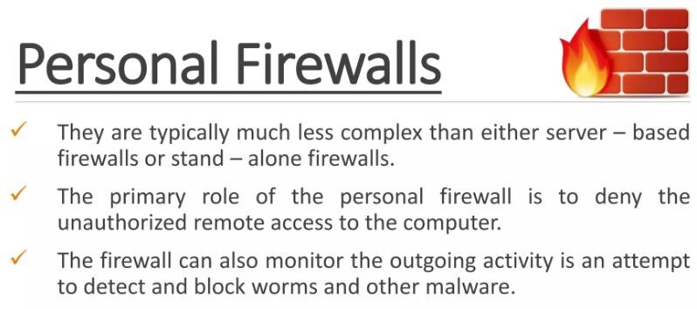

Slide 28
Figure 9.2 illustrates a common firewall configuration that includes an additional network segment between an internal and an external firewall. An external firewall is placed at the edge of a local or enterprise network, just inside the boundary router that connects to the Internet or some wide area network (WAN). One or more internal firewalls protect the bulk of the enterprise network. Between these two types of firewalls are one or more networked devices in a region referred to as a DMZ (demilitarized zone) network. Systems that are externally accessible but need some protections are usually located on DMZ networks. Typically, the systems in the DMZ require or foster external connectivity, such as a corporate Web site, an e-mail server, or a DNS (domain name system) server.
The external firewall also provides a basic level of protection for the remainder of the enterprise network. In this type of configuration, internal firewalls serve three purposes:

Slide 29
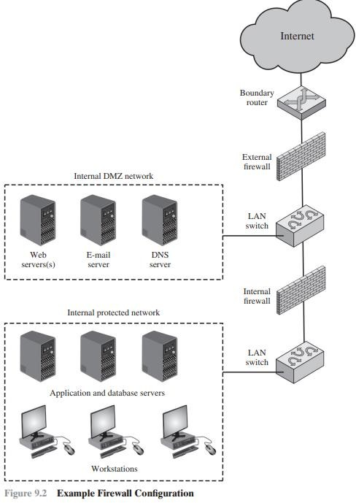

Slide 30
The internal firewall adds more stringent filtering capability, compared to the external firewall, in order to protect
enterprise servers and workstations from external attack.
The internal firewall provides two-way protection with respect to the DMZ. First, the internal firewall protects the remainder of the network from attacks launched from DMZ systems. Such attacks might originate from worms, rootkits, bots, or other malware lodged in a DMZ system. Second, an internal firewall can protect the DMZ systems from attack from the internal protected network.
Multiple internal firewalls can be used to protect portions of the internal network from each other. For example, firewalls can be configured so that internal servers are protected from internal workstations and vice versa. It also illustrates the common practice of placing the DMZ on a different network interface on the external firewall from that used to access the internal networks.

Slide 31
virtual private network (VPN) consists of a set of computers that interconnect by means of a relatively unsecure network and that make use of encryption and special protocols to provide security. At each corporate site, workstations, servers, and databases are linked by one or more local area networks (LANs). The Internet or some other public network can be used to interconnect sites, providing a cost savings over the use of a private network and offloading the wide area network management task to the public network provider. That same public network provides an access path for telecommuters and other mobile employees to log on to corporate systems from remote sites.
Figure 9.3 is a typical scenario of IPSec usage. An organization maintains LANs at dispersed locations. Nonsecure IP traffic is used on each LAN. For traffic off site, through some sort of private or public WAN, IPSec protocols are used. These protocols operate in networking devices, such as a router or firewall, that connect each LAN to the outside world. The IPSec networking device will typically encrypt and compress all traffic going into the WAN and decrypt and uncompress traffic coming from the WAN; authentication may also be provided. These operations are transparent to workstations and servers on the LAN. Secure transmission is also possible with individual users who dial into the WAN. Such user workstations must implement the IPSec protocols to provide security. They must also implement high levels of host security, as they are directly connected to the wider Internet. This makes them an attractive target for attackers attempting to access the corporate network

Slide 32
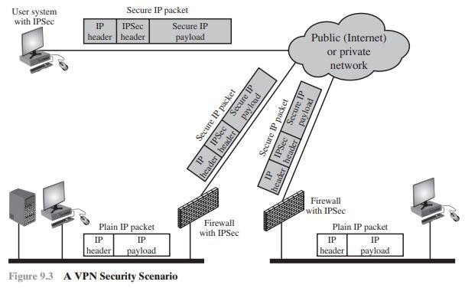

Slide 33
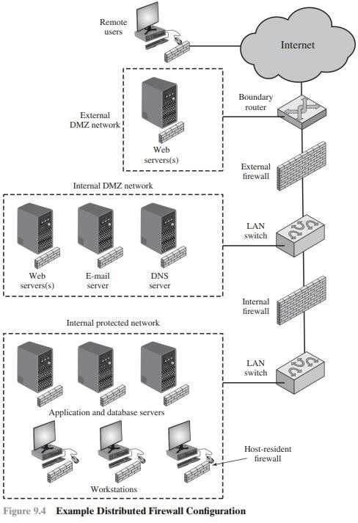

Slide 34
A distributed firewall configuration involves stand-alone firewall devices plus host based firewalls working together under a central administrative control. Figure 9.4 suggests a distributed firewall configuration. Administrators can configure host resident firewalls on hundreds of servers and workstation as well as configure personal firewalls on local and remote user systems. Tools let the network administrator set policies and monitor security across the entire network. These firewalls protect against internal attacks and provide protection tailored to specific machines and applications. Stand-alone firewalls provide global protection, including internal firewalls and an external firewall.
With distributed firewalls, it may make sense to establish both an internal and an external DMZ. Web servers that need less protection because they have less critical information on them could be placed in an external DMZ, outside the external firewall. What protection is needed is provided by host-based firewalls on these servers.

